Slide 1







Emerging Technology Skills
Dimitrios Fortis
February 8th of 2023

Slide 2



OUTLINE
Executive Summary
Introduction
Methodology
Results
Visualization – Charts
Dashboard
Discussion
Findings & Implications
Conclusion
Appendix

Slide 3

EXECUTIVE SUMMARY
Company’s Aim → Profitability & Customer satisfaction;
How ? → Remain competitive by keeping up-to-date with the constantly changing technologies;
Presentation’s Aim → Find the technologies that have been used the most this year & identify future skill requirements;
Presentation’s key points → Current & Future Trends in Programming Languages, Databases, Platforms & Web Frames in the market;
Key takeaways→ Push Company to more informed and data-driven decision making.

Slide 4

INTRODUCTION
The Presentation’s purpose will give insights to the responsible business’ stakeholders, in effective decision making upon IT Consulting Services;
Answering the right questions, namely which are the current and immerging technologies in the market will drive the company to identify future skill requirements, utterly making the provided services more effective and precise;
Along the presentation, ideas and recommendations will be provided, based on the implementing Data Analysis techniques.

Slide 5

METHODOLOGY
Starting with a modified subset of the Stack Overflow dataset, the data were wrangled in order to remove duplicates, impute missing values & normalize them;
After that, the data underwent exploratory analysis in order to find the distribution of them, presence of outliers & determine the correlation between different columns in the dataset;
The third part was all about the visualization of the distribution the inter-relationship & the composition & comparison of data;
Finally, by utilizing two new files which were also modified subset of Stack Overflow dataset, a Dashboard was created through Cognos Dashboard Embedded (CDE), showing the ‘Current Technology Usage’, ‘Future Technology Usage’ & ‘Demographics’ in the three tabs, respectively.
In the Appendix section a box-plot and a table of the participants’ age and type of job, respectively is shown up, that was created through the Analysis process (Data collection through APIs and Web Scraping from Kaggle & GitHub)

Slide 6
RESULTS

Slide 7
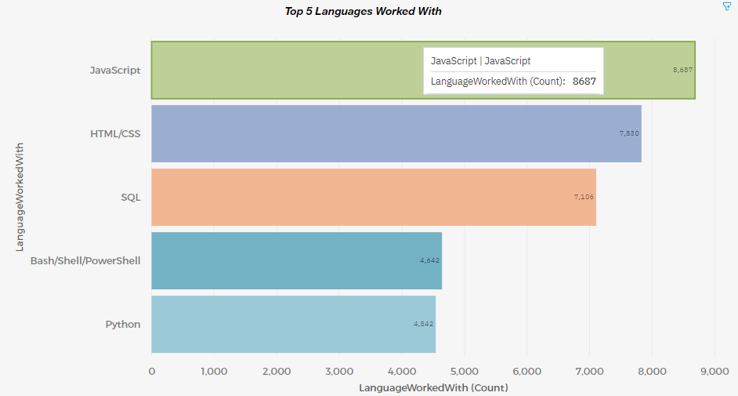
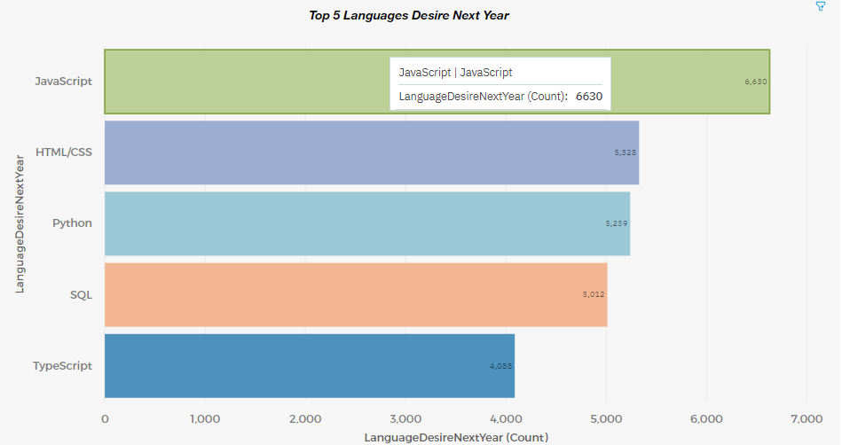
PROGRAMMING LANGUAGE TRENDS
Current Year
Next Year

Slide 8
PROGRAMMING LANGUAGE TRENDS - FINDINGS & IMPLICATIONS
Findings
JavaScript & HTML/CSS are the top two most popular programming languages for both this & the next year;
Python & TypeScript is shown to gain the interest of the respondents;
The interest in SQL & Bash/ Shell/ PowerShell has decreased.
Implications
Steady employment for individuals with JavaScript & HTML/CSS skills;
More demand for individuals with Python & TypeScript skills;
Less demand for individuals with SQL & Bash/ Shell/ PowerShell skills.

Slide 9
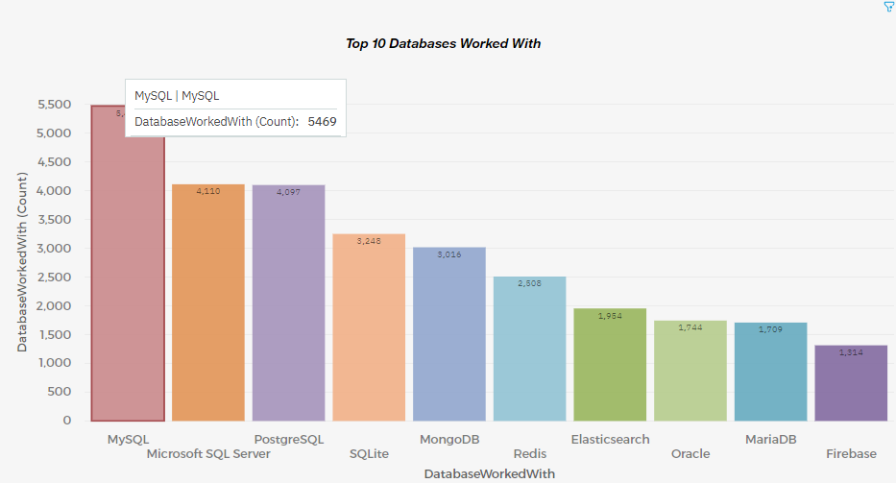
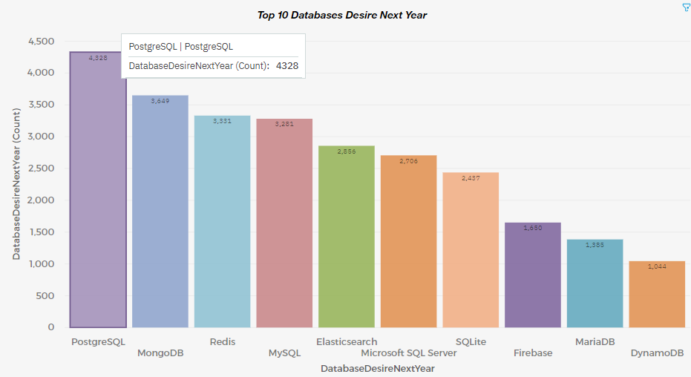
DATABASE TRENDS
Current Year
Next Year

Slide 10
DATABASE TRENDS - FINDINGS & IMPLICATIONS
Findings
PostgreSQL & MongoDB is shown to gain the interest of the respondents;
MySQL’s, Microsoft SQL Server’s & SQLite’s interest is decreasing among the respondents;
The interest in Redis/ Elasticsearch is increasing for the next year.
Implications
More demand for individuals with PostgreSQL & MongoDB skills;
Less demand for individuals with MySQL, Microsoft SQL Server & SQLite skills.
More demand for individuals with Redis/ Elasticsearch skills.

Slide 11

DASHBOARD
You can be redirected to the official dashboard through the following link:
https://dataplatform.cloud.ibm.com/dashboards/f631466a-282a-407a-96fb-864849e8edca/view/533cd90c6eb708e55ce0c0e407cf2f037534225ce1bb835682d77b490c312397f33b1098c8281d53d3110d37a0ec415a9b

Slide 12
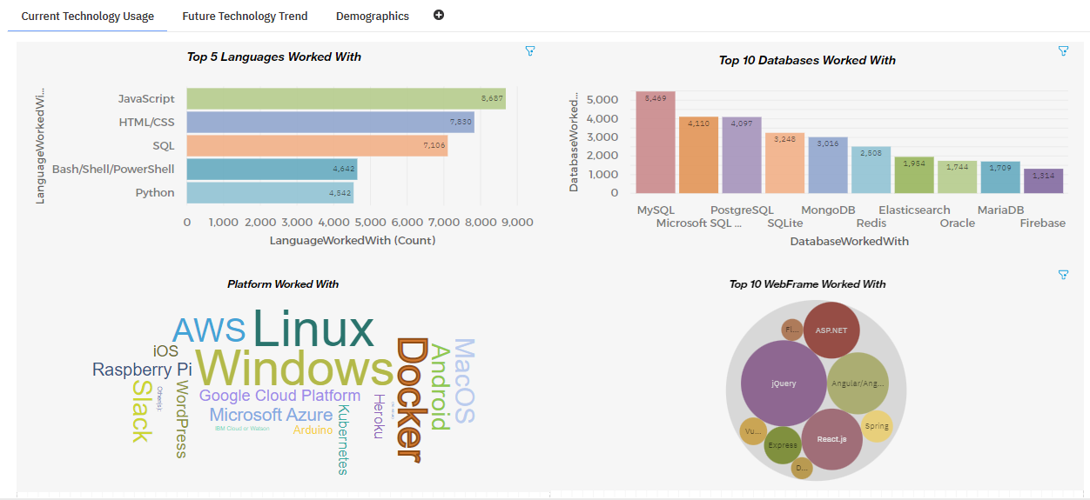
DASHBOARD TAB 1

Slide 13
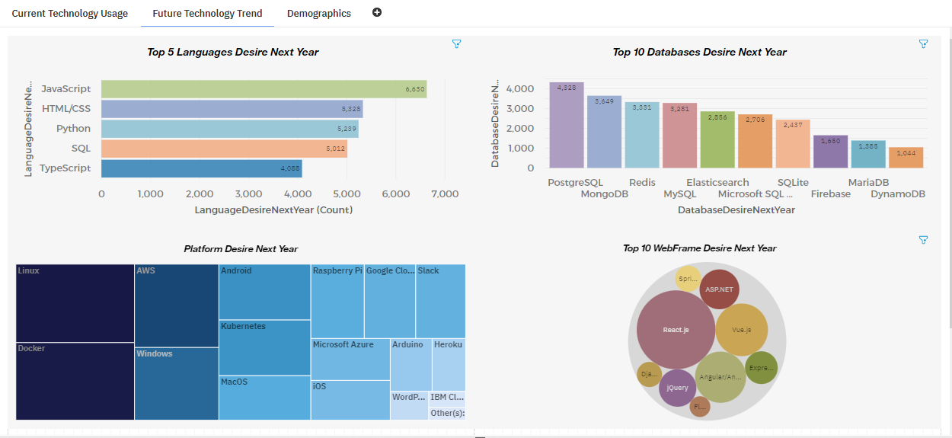
DASHBOARD TAB 2

Slide 14
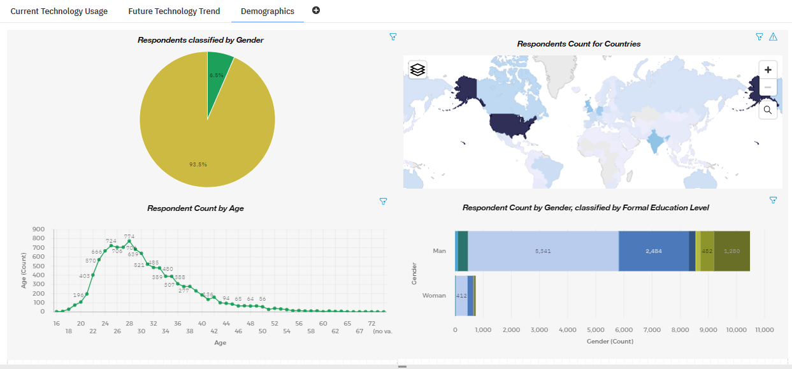
DASHBOARD TAB 3

Slide 15
DISCUSSION

Slide 16
OVERALL FINDINGS & IMPLICATIONS
Findings
Programming Languages: Python & TypeScript is shown to gain the interest of the respondents;
Databases: PostgreSQL, MongoDB, Redis & Elasticsearch are gaining more interest;
Platforms: Interest for Slack & Windows is decreasing, opposing to an increase in Docker, AWS &Android skills;
WebFrames: Vue.js is gaining developers’ interest as well as React.js.
Implications
Steady employment of individuals with JavaScript & HTML/CSS skills but also Python & TypeScript skills will be great among the candidates;
More demand for individuals with PostgreSQL, MongoDB, Redis & Elasticsearch skills;
Linux, Docker, AWS & Android skills will be necessary among the future candidates;
Steady employment of individuals with ASP.NET skills but also Vue.js & React.js skills will be necessary among the candidates.

Slide 17

CONCLUSION
Recommendations:
Offering educational programs to the staff that is already established into the company;
Providing them with the adequate tools to upscale their knowledge in the up-to-date technologies;
Making rearrangements & prioritizing technologies that are “on demand”;
Hiring additional staff, with the adequate skills wherever it is believed that is needed.

Slide 18

APPENDIX

Slide 19
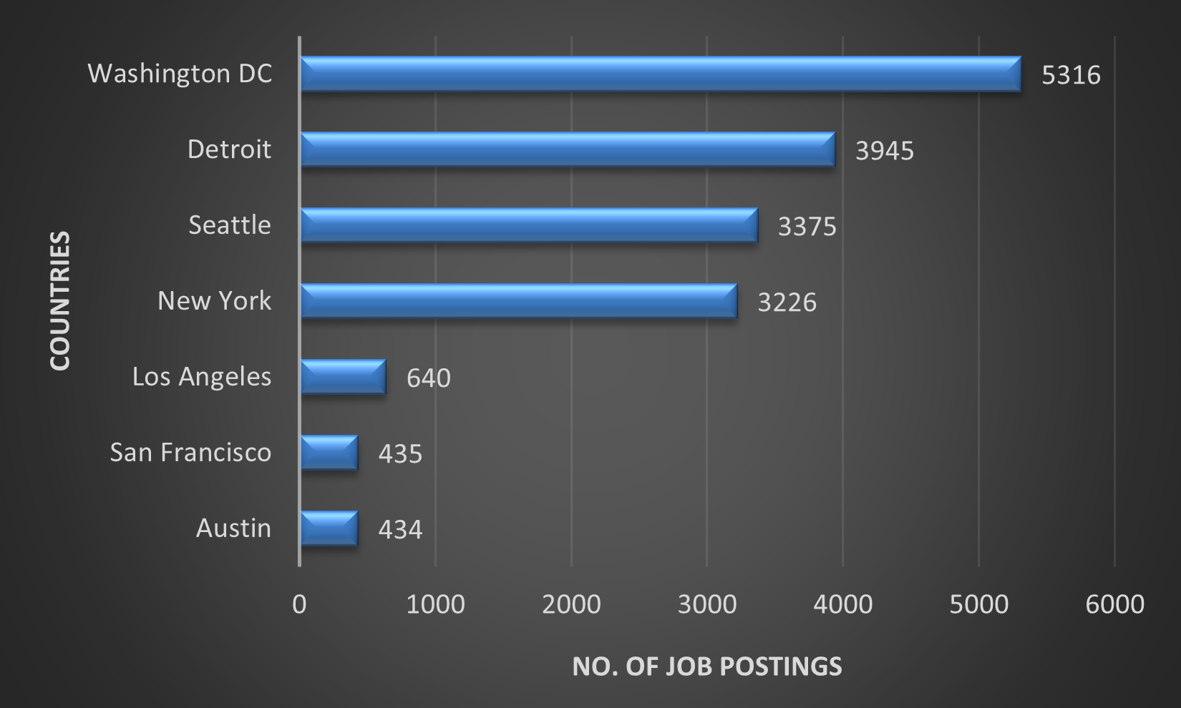
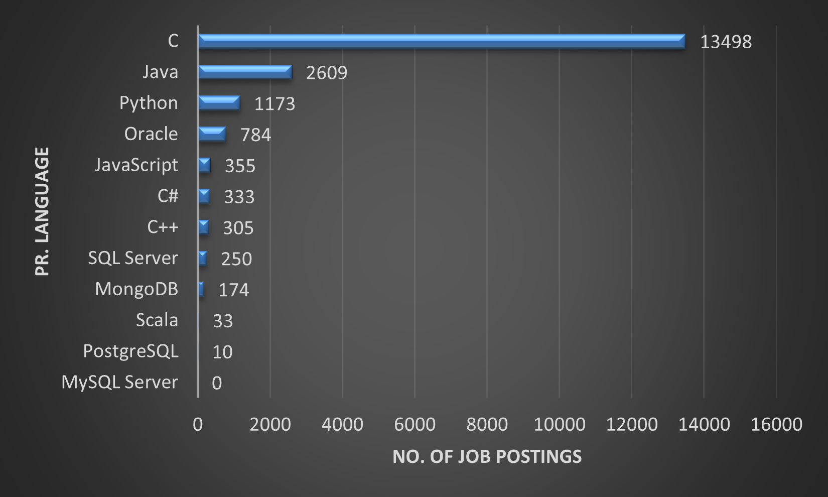
JOB POSTINGS (using APIs)
No. of Job Postings per State
No. of Job Postings per Pr. Language

Slide 20
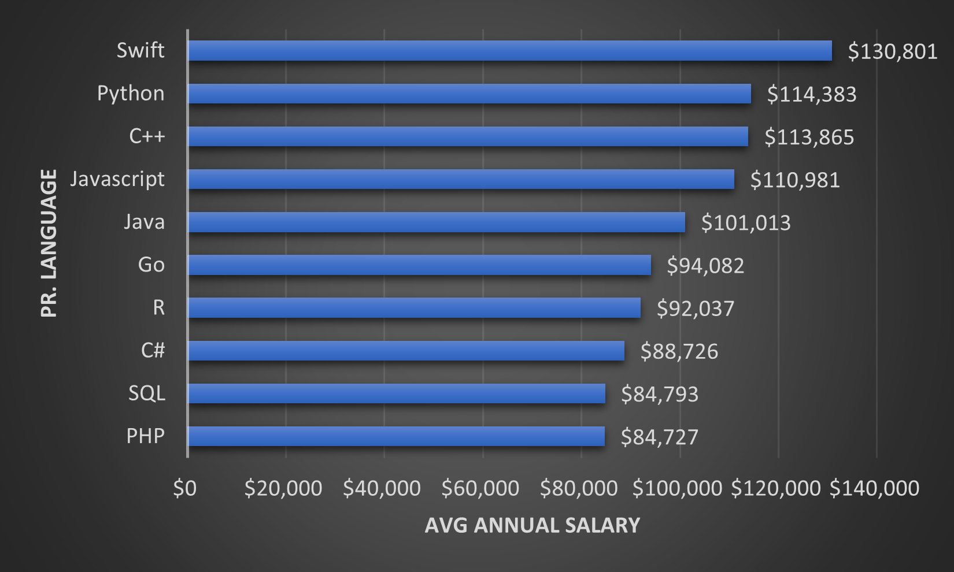
POPULAR LANGUAGES (using Web Scraping)
Average Annual Salary per Pr. Language

Slide 21
Resources & References
Resources
https://www.kaggle.com/promptcloud/jobs-on-naukricom
https://cf-courses-data.s3.us.cloud-object-storage.appdomain.cloud/IBM-DA0321EN-SkillsNetwork/labs/module%201/Accessing%20Data%20Using%20APIs/jobs.json
https://cf-courses-data.s3.us.cloud-object-storage.appdomain.cloud/IBM-DA0321EN-SkillsNetwork/labs/datasets/Programming_Languages.html
https://stackoverflow.blog/2019/04/09/the-2019-stack-overflow-developer-survey-results-are-in/?utm_medium=Exinfluencer&utm_source=Exinfluencer&utm_content=000026UJ&utm_term=10006555&utm_id=NA-SkillsNetwork-wwwcourseraorg-SkillsNetworkCoursesIBMDA0321ENSkillsNetwork21426264-2022-01-01
Image references
https://www.istockphoto.com/de/fotos/data-analysis
https://lovepik.com/image-400059759/data-analysis.html

Slide 22
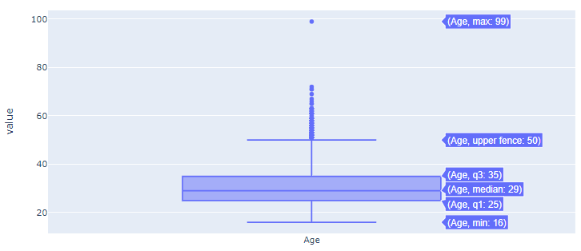
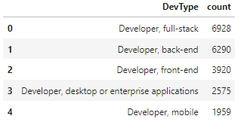
Additional Material
Age of participants (Box Plot)
No. of respondents per Type of Job

